Slide 1
Skybank
Taking over home banking
Notes:
David

Slide 2
Technologies
Frontend
HTML
CSS
React
TypeScript
Redux
Axios
JavaScript
Backend
Java
PostgreSQL
Maven
Javalin
DBeaver
JDBC
Notes:
Josiah

Slide 3
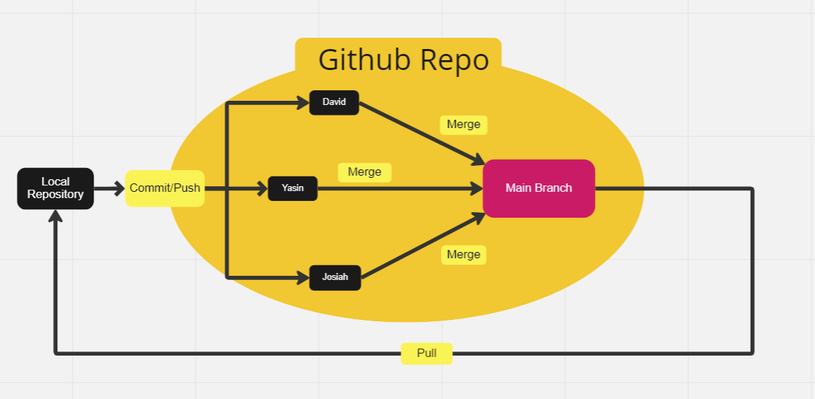
GitFlow
Notes:
Yasin

Slide 4
Team Structure
David: GitFlow, Frontend
Yasin: Fullstack
Josiah: Backend
Notes:
David

Slide 5
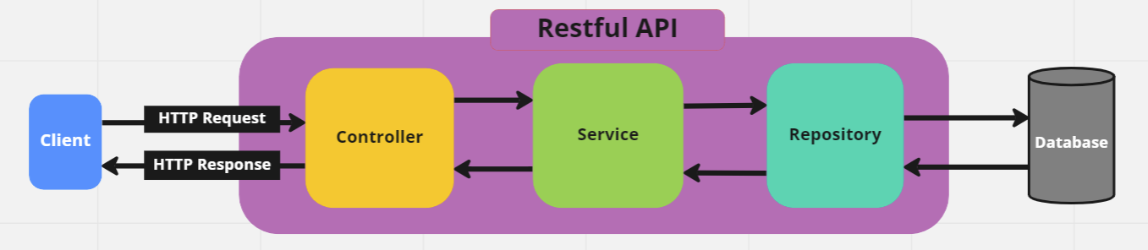
Architecture Diagram
Notes:
Josiah

Slide 6
Agile/Scrum Implementation
Daily Standup
Updated Trello Board
Story points
Spring Planning (figma)
Sprint Review (meeting with client)
Working Software (JDBC over Spring)
Sprint Retrospective
Notes:
Yasin

Slide 7
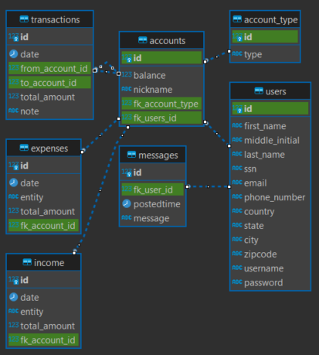
ERD Diagram
Notes:
David

Slide 8
Implemented Features
Open Account
Register
Login/Logout
User Profile
Track Multiple accounts
Transfer Money Between Accounts
Track Income and Expenses
Send Money
Dark Mode
Notifications
Notes:
Josiah

Slide 9
Challenges Faced
Unit Testing
Spring
Implementing Other APIs
Time management
Gitignore issue with target files.
Notes:
Yasin

Slide 10
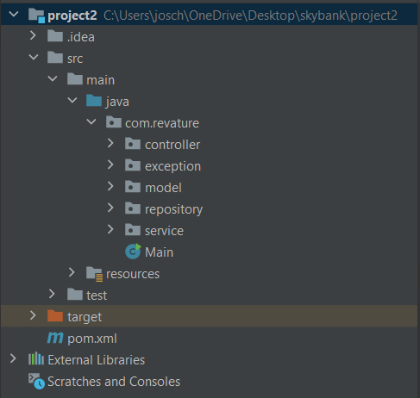
Backend Demo

Slide 11
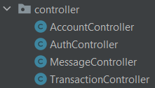
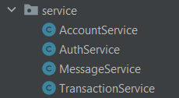
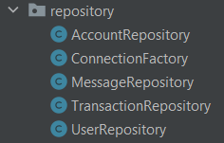
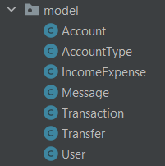
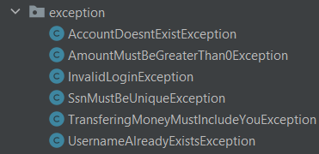
Backend Demo

Slide 12
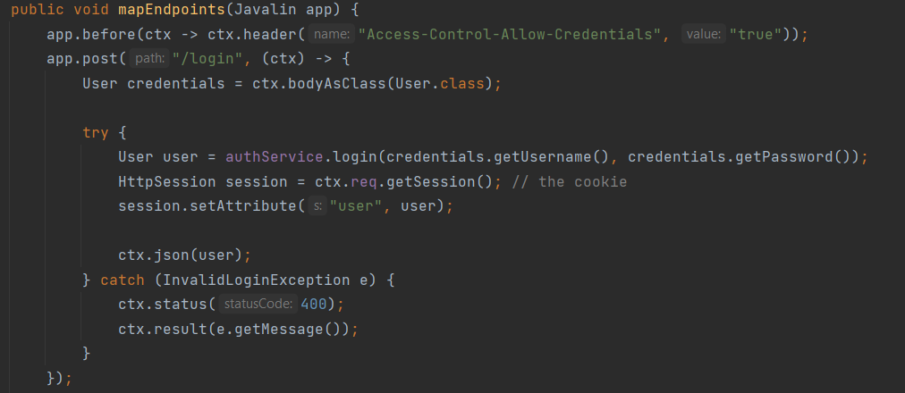
Backend Demo

Slide 13
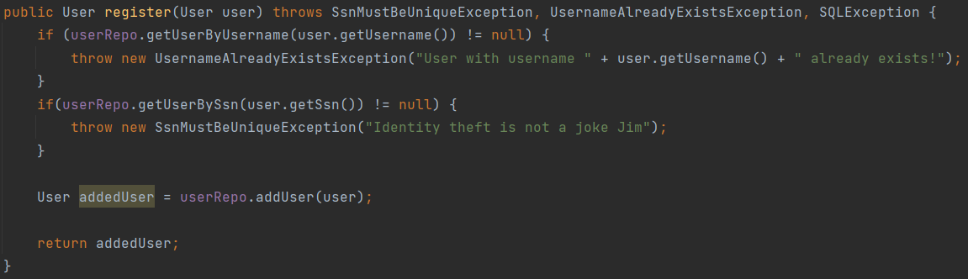
Backend Demo

Slide 14
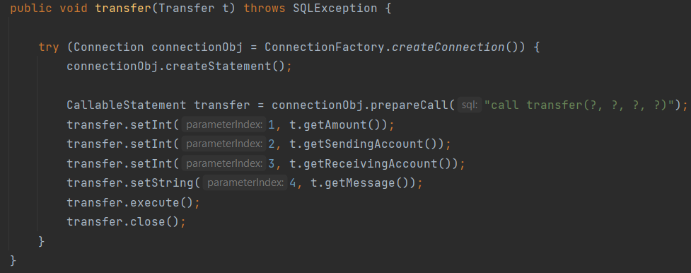
Backend Demo

Slide 15
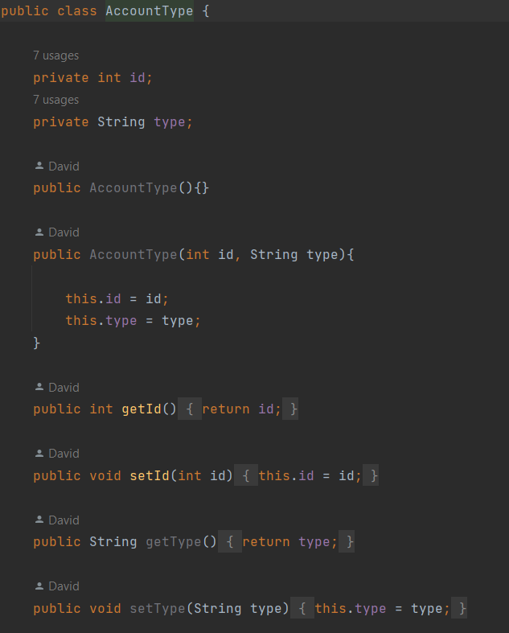
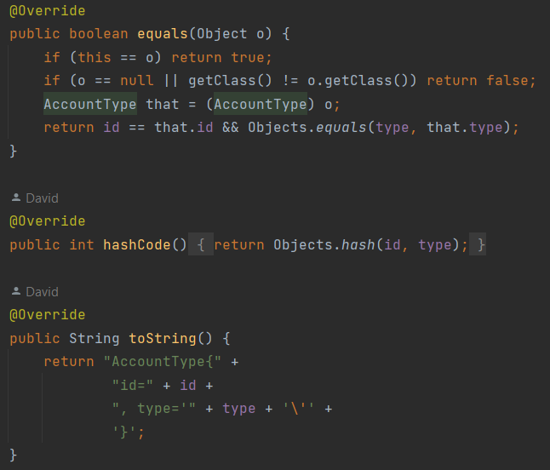
Backend Demo

Slide 16
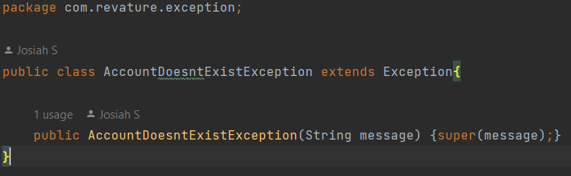
Backend Demo
Custom Exceptions

Slide 17



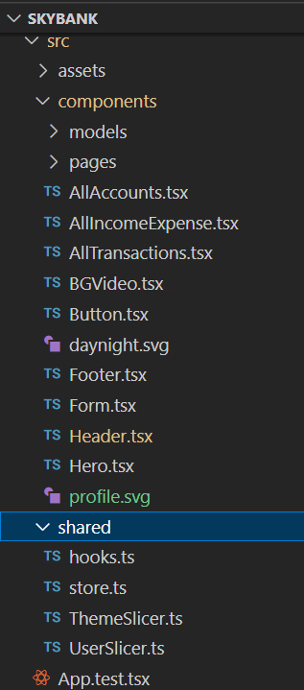
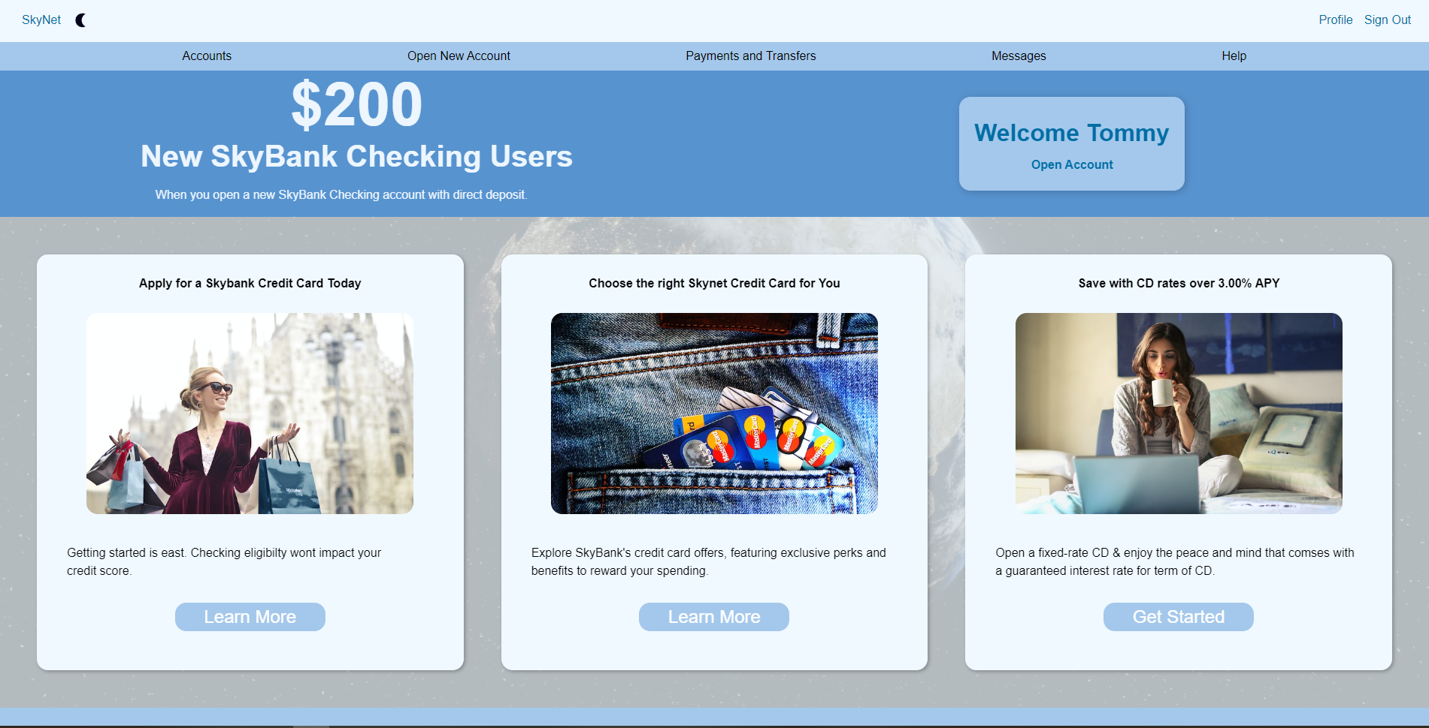
React with Typescript

Slide 18
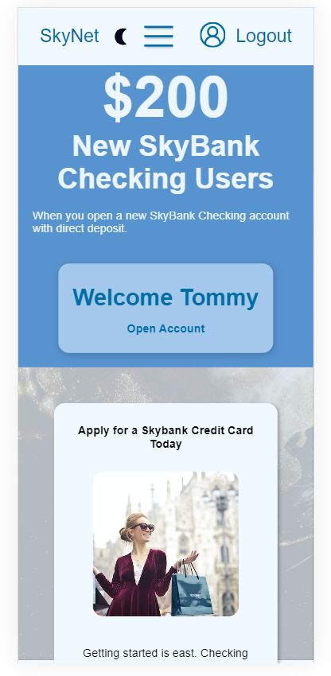

Frontend Demo
Responsive Design

Slide 19
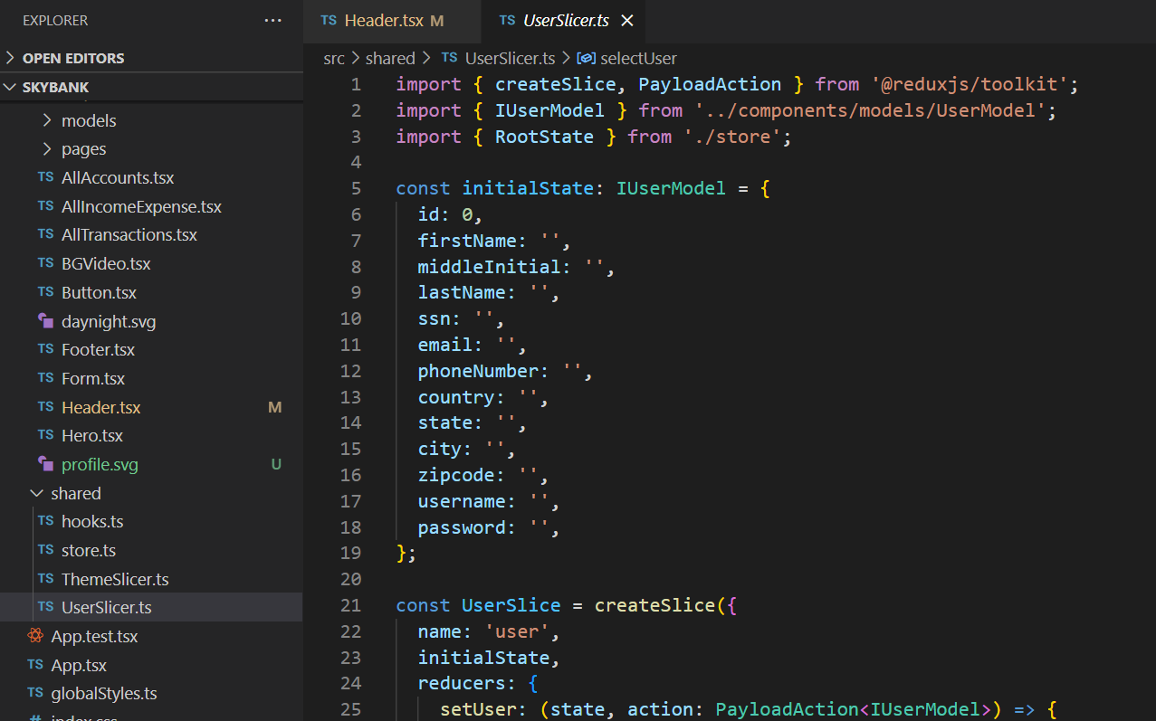

Frontend Demo
State Management with Redux

Slide 20
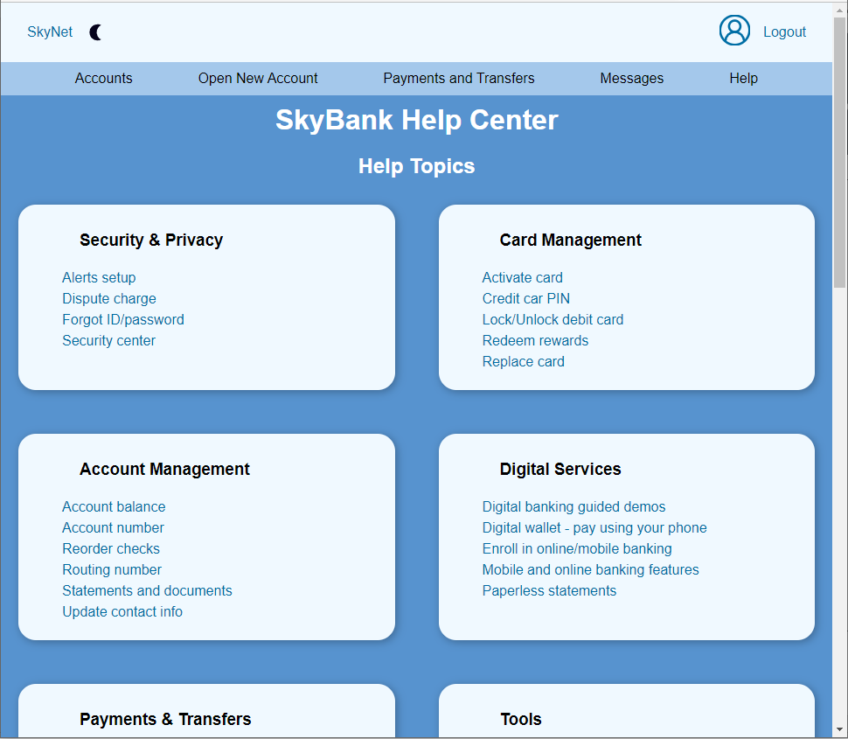
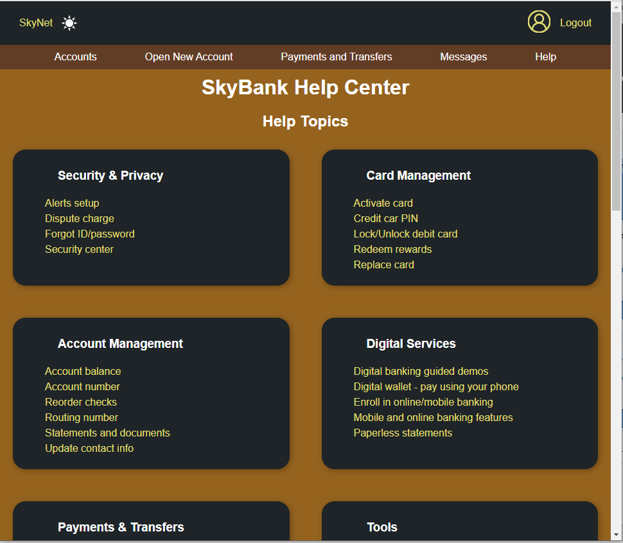
Frontend Demo
Day/Night mode

Slide 21

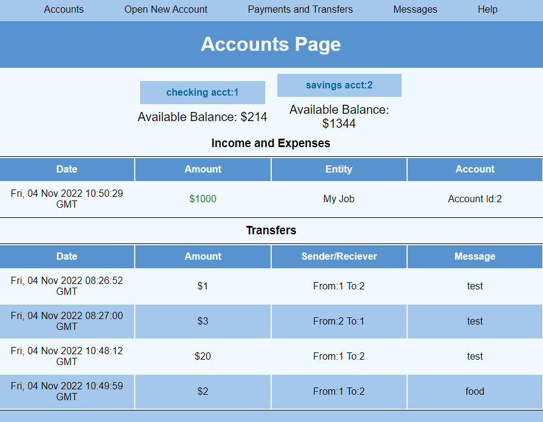
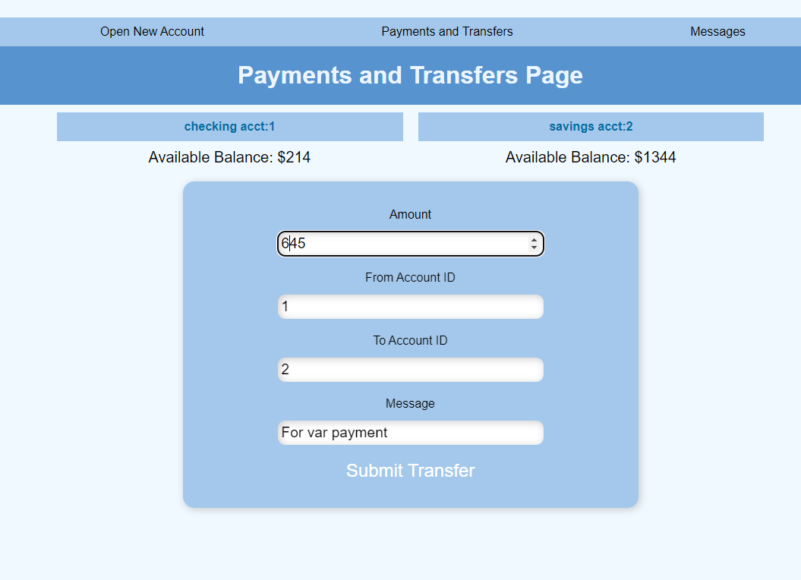
Frontend Demo
HTTP requests

Slide 22
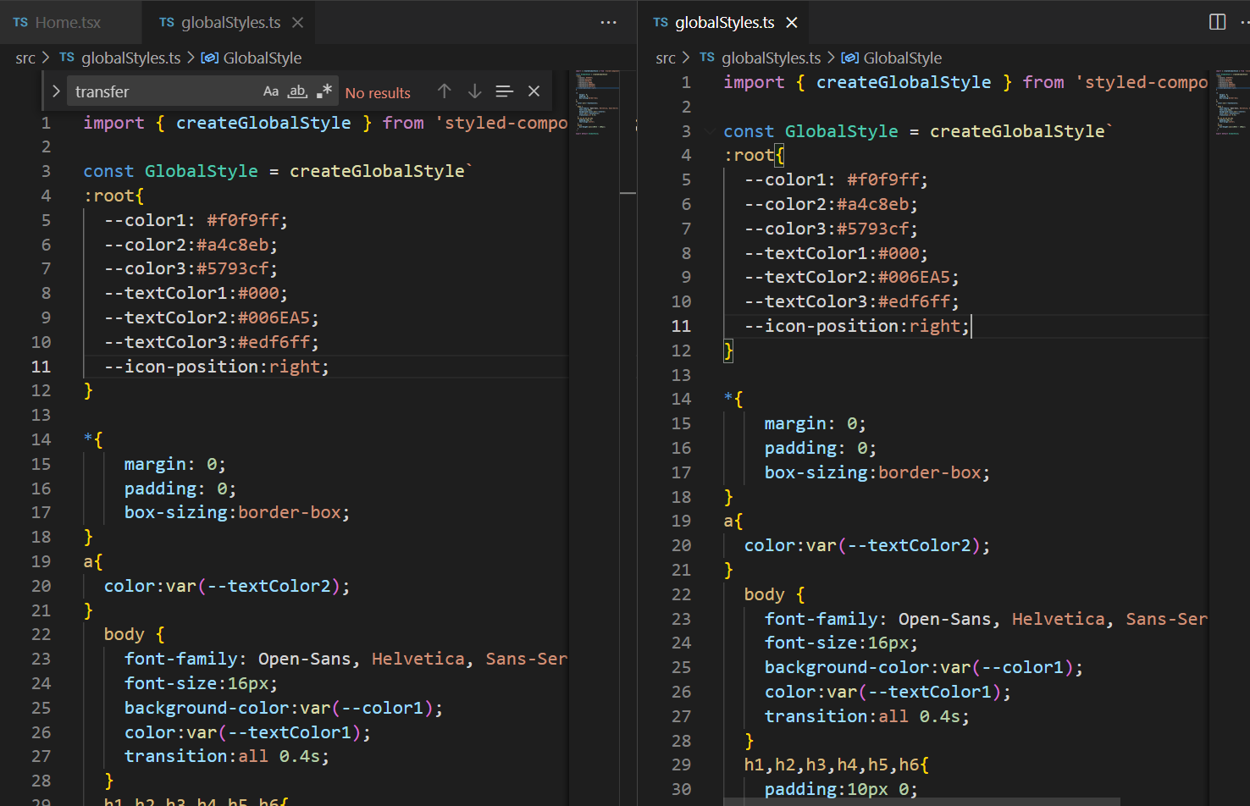
Front End Demo
React Styled Component + CSS Variables

Slide 23

That’s all for the slideshow

